Slide 1

V JUSWANTH
412721205023
TAGORE ENGINEERING COLLEGE

Slide 2

Introduction to Leaf Disease Detection
Leaf disease detection using deep learning involves the identification and classification of plant diseases through advanced technology. It aims to provide a method for farmers and botanists to promptly identify and address plant health issues.

Slide 3

Agenda
1
Identifying Project Objectives
Understanding the goals of leaf disease detection.
2
Data Collection and Preprocessing
Gathering and preparing the data for model training.
3
Model Training and Validation
Training the deep learning model and validating its accuracy.

Slide 4

Project Statement
1
Problem Statement
2
Scope and Impact
Identifying the need for efficient leaf disease detection in agriculture.
Discussing the potential impact and scope of the project.
3
Technical Challenges
Exploring the technological challenges associated with the project.

Slide 5
Project Overview
Data Collection
Model Development
Deployment Strategy
Gathering leaf images from various sources.
Constructing a deep learning model for disease classification.
Planning the deployment of the solution in real-world scenarios.
Ensuring a diverse dataset for accurate model training.
Implementing advanced algorithms and frameworks.
Ensuring ease of use and scalability.

Slide 6



Who are the End Users?
Farmers
Botanists
Agricultural Researchers
Utilizing the technology for crop health monitoring.
Researching and analyzing plant diseases more effectively.
Contributing to advancements in agricultural science.

Slide 7



Your Solution and its Value Proposition
Accuracy
Efficiency
Scalability
Providing precise disease identification and classification.
Offering a rapid and automated solution for disease detection.
Adapting to varying scales of agricultural operations.

Slide 8

The Wow in Your Solution
Advanced Technology
Real-time Analysis
Utilizing cutting-edge deep learning algorithms.
Providing instant feedback and diagnosis.
User-Friendly Interface
Ensuring ease of use for non-technical users.

Slide 9
Modeling
Deep Learning Algorithm
Utilizing CNN for image analysis.
Data Augmentation
Enhancing model robustness and generalization.
Validation Metrics
Measuring precision, recall, and F1 score.

Slide 10
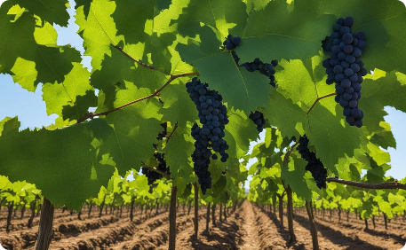
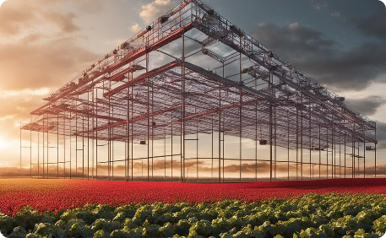
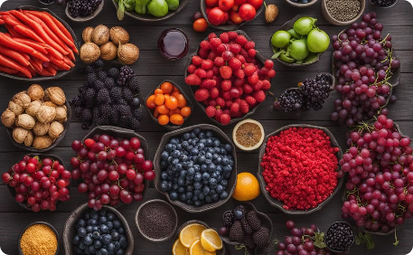
Conclusion
Positive Impact
Innovation in Agriculture
Collaborative Growth
Healthy crops leading to better yields and sustainable agriculture.
Empowering agricultural communities through collaborative efforts.
Elevating agricultural practices through technological advancement.

